Slide 1


User Interface Guide
Prepared for:
Introduction
This document highlights the Crestron User Interface and associated functionality.

Slide 2
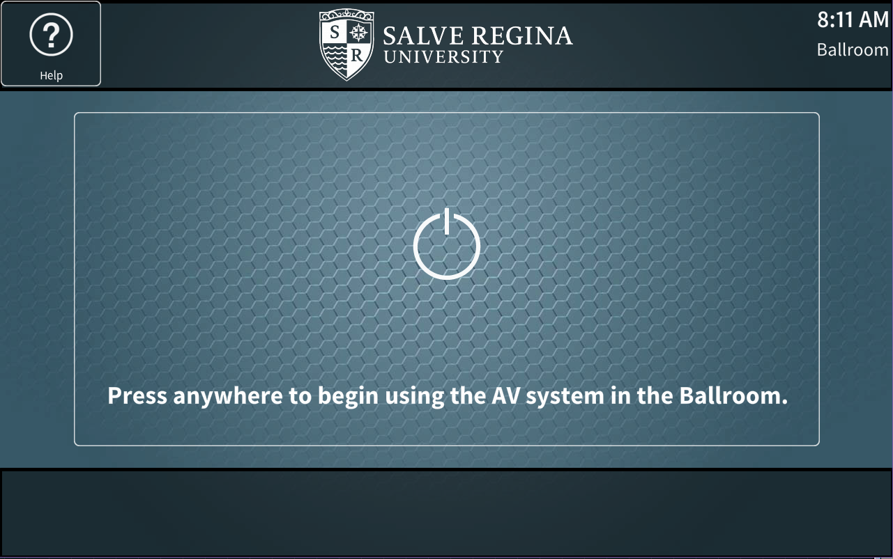
Getting Started – All Panels
The default logo page when the panel is not in use.
The user can touch anywhere on the screen to begin using. The text displayed on the touch-panel will be adjusted to reflect the room the unit is installed in. In the case of the iPad the text will change based on which room the iPad is currently controlling.

Slide 3
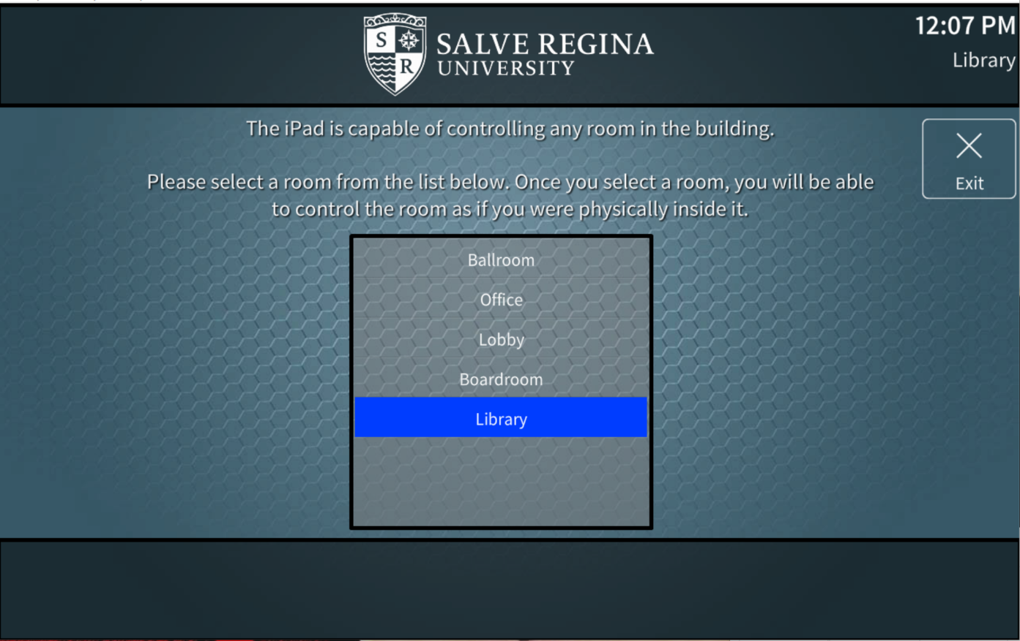
Selecting A Room For Control - iPad
On the iPad only there will be a header item allowing for room control selection. This will allow the end user to control a room as if they were inside it using one of the touch-panels located in the room. This page is separate from the room linking controls.

Slide 4
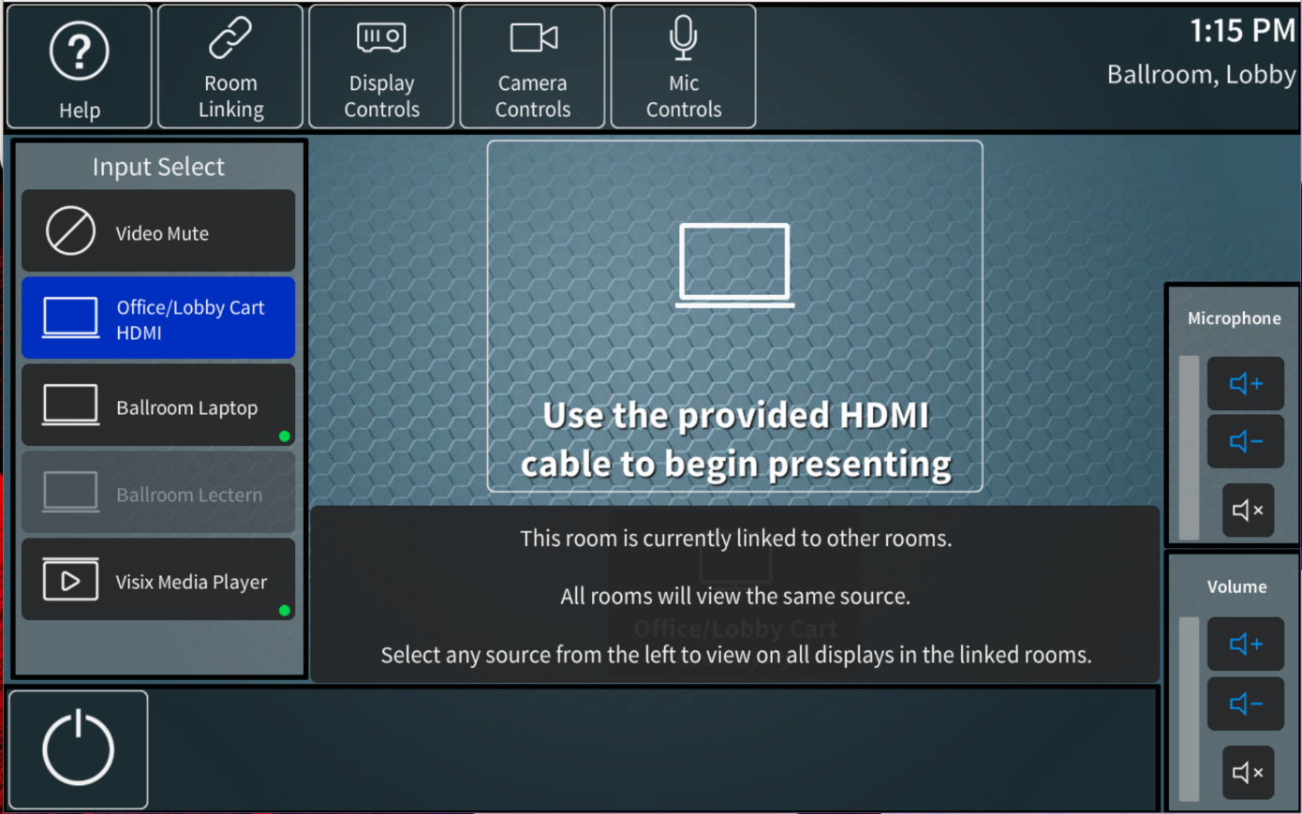
Accessing Room Linking Controls
To access the room linking controls, the user must first press the room linking button. If this is the first time the user has pressed the button since the room has turned on, the user will be asked to enter a passcode. The login status of a panel will be reset once the system has been shut down and the next user will be forced to enter the passcode again. This passcode will not be required on the iPad as it shall only be used by advanced users

Slide 5
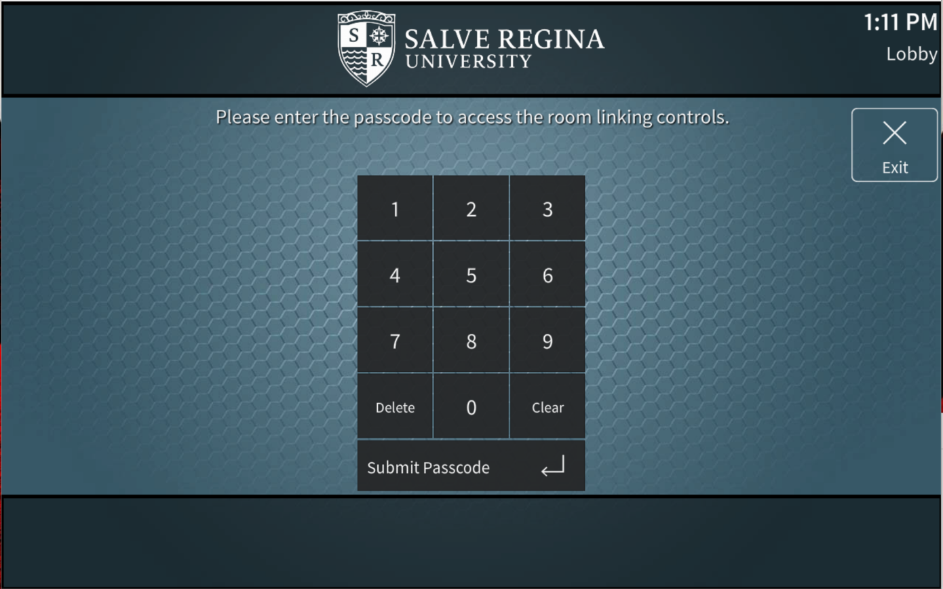
Passcode Entry – Room Panels Only
The passcode page will be shown only on the following panels: Ballroom
Boardroom
Lobby
Library This will prevent unauthorized users from linking rooms and attempt to prohibit sensitive material from being broadcast to other rooms mistakenly. The user will use the keypad to enter the passcode and click the submit passcode button. If they enter a correct passcode, they will be brought immediately to the Room Linking page. If they enter an incorrect passcode, an error message will be shown.

Slide 6
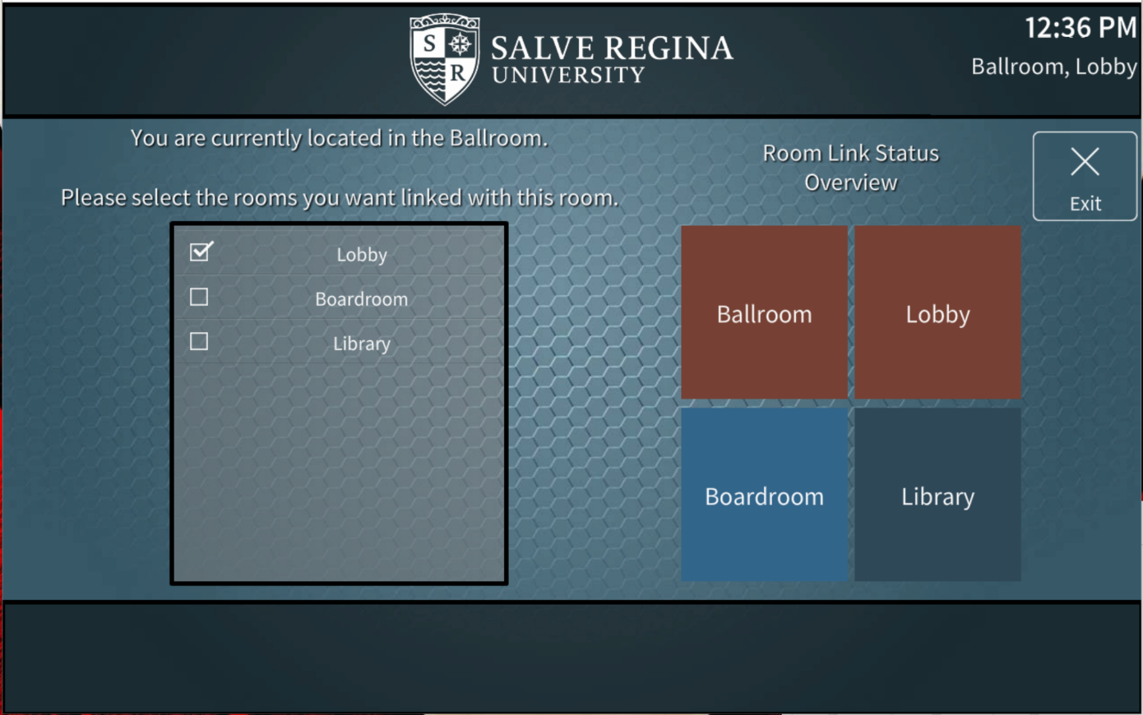
Linking Rooms
The following rooms will be able to be linked: Ballroom
Lobby
Boardroom Library The Office cannot be linked, and therefore the touch-panel installed its mobile cart will not have access to room linking controls.
(note: if the iPad has selected the Office as the room it wants to control, no linking button will be shown. A valid room must be selected to control for the Room Linking button to appear)
In this example, the Ballroom and Lobby are linked, and the Boardroom and Library are acting as independent rooms.

Slide 7
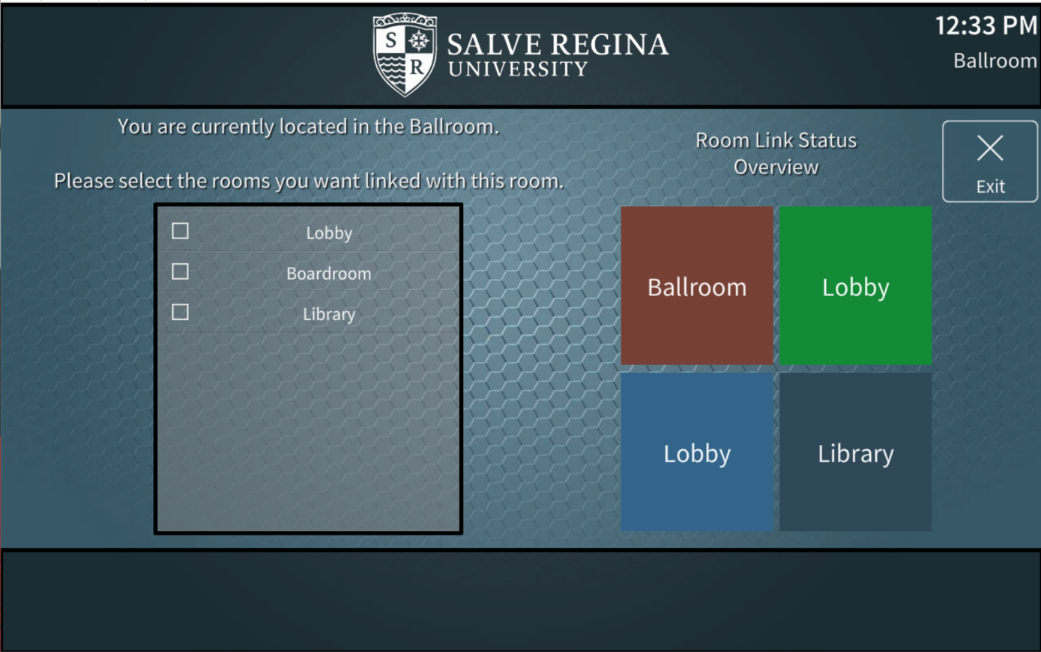
Linking Rooms – Cont.
As shown in the examples, multiple selections can be made to link any combination of rooms to one another. The list on the left-hand side will be changed depending on which room the touch-panel immediately, reflecting what rooms are eligible to be linked. The Room Link Status Overview section [denoted by the orange arrow] is a visual representation of the linked status of all the rooms in the building. The colors will change as shown in the next slides to indicate which rooms are linked together. An end user should look at this before making the decision to change the link status of a room, as doing so could interrupt presentations in progress.
In this example, all rooms are independent.

Slide 8
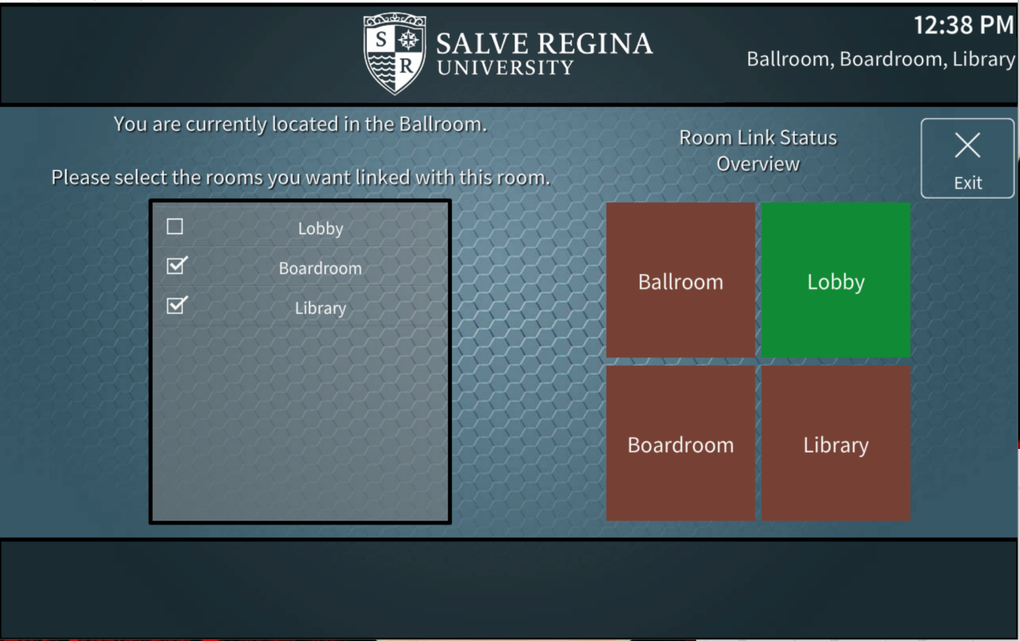
Linking Rooms – Cont.
In this example, the Ballroom, Boardroom and Library are all linked, acting as one room. The Lobby is independent, acting alone.

Slide 9
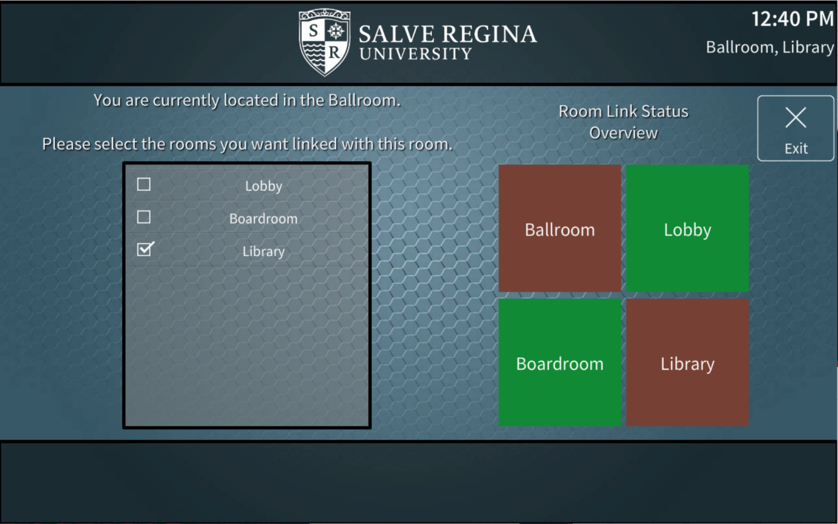
Linking Rooms – Cont.
In this example, the touch-panel shown is in the Ballroom. Currently the Ballroom and Library are linked. In a separate link group, the Boardroom and Lobby are linked together. This would be reflected on the touch-panels in those rooms.

Slide 10
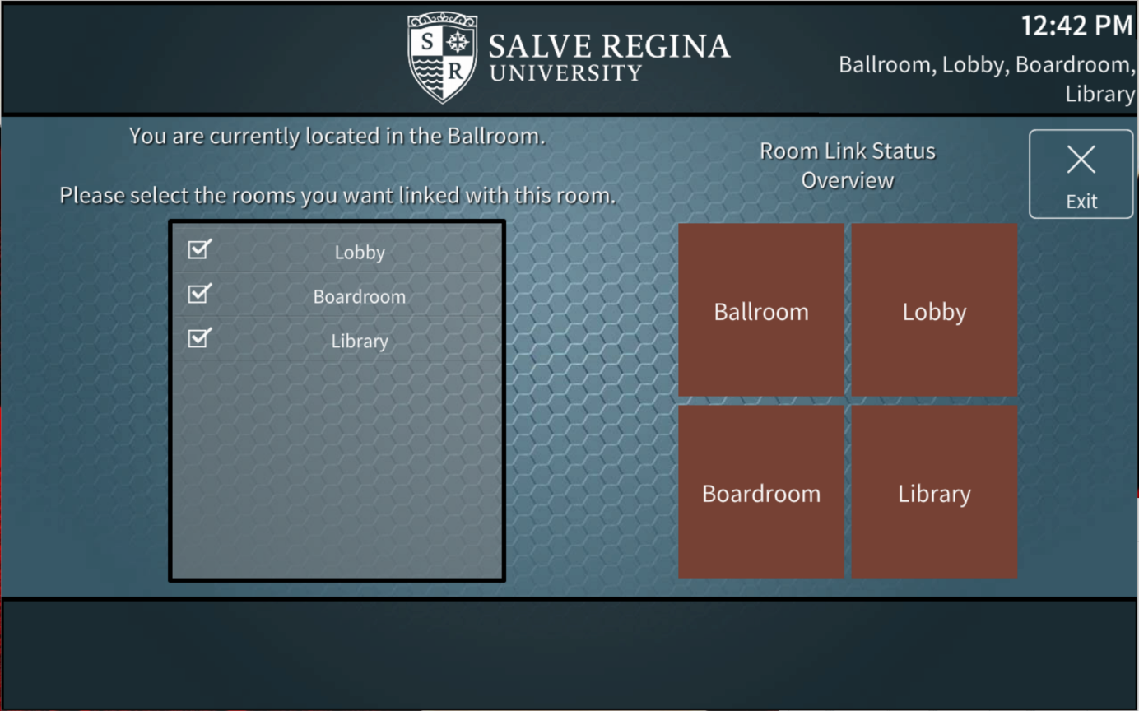
Linking Rooms – Cont.
In this example, all four rooms are linked together, acting as one massive space.

Slide 11
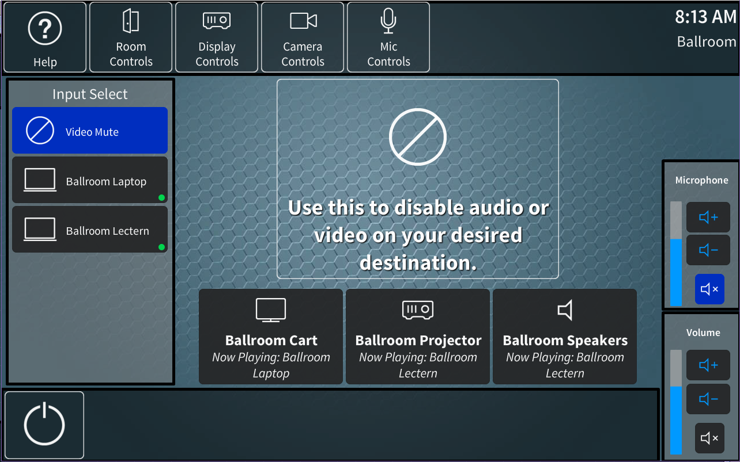
Source Selection & Routing - Unlinked
The user interfaces in each room will have their available sources display on the left column. The available destinations will be shown in a list towards the bottom. Depending on the room, scrolling right or left using a swiping motion to see all destinations may be required. To route a source, a user will select the source the desire, then press the destination they desire. If this destination is a video display or projector the display will turn on, and if applicable, the projection screen will also drop.

Slide 12
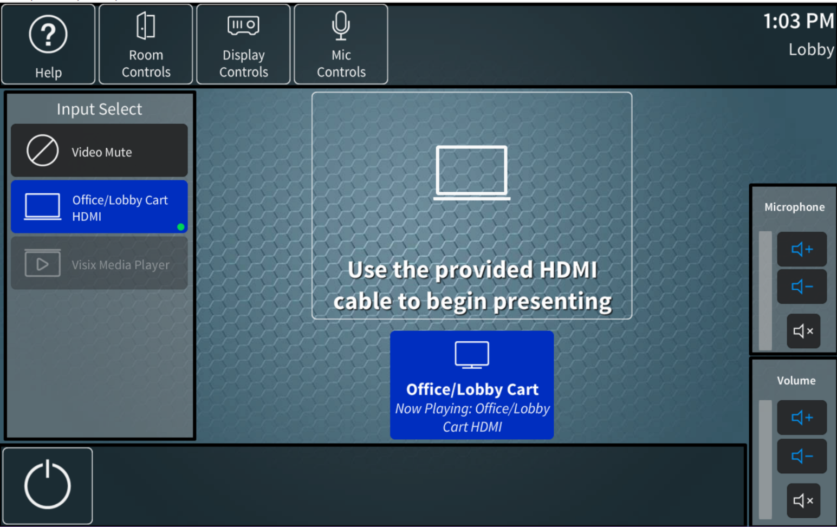
Source Selection & Routing - Unlinked
To indicate to an end user that the display they have routed a source to is powered on, the destination button will turn blue. This will only be applicable to video destinations [any Speaker destination will stay grey]

Slide 13

Source Selection - Linked
When a room is linked to any other room, this message will be shown. For simple operation by end users, all displays will view the same source in a set of linked rooms. Selecting the desired source will cause it to be seen and heard across the linked rooms. This would also cause any displays that were previously off to turn on [if applicable]

Slide 14
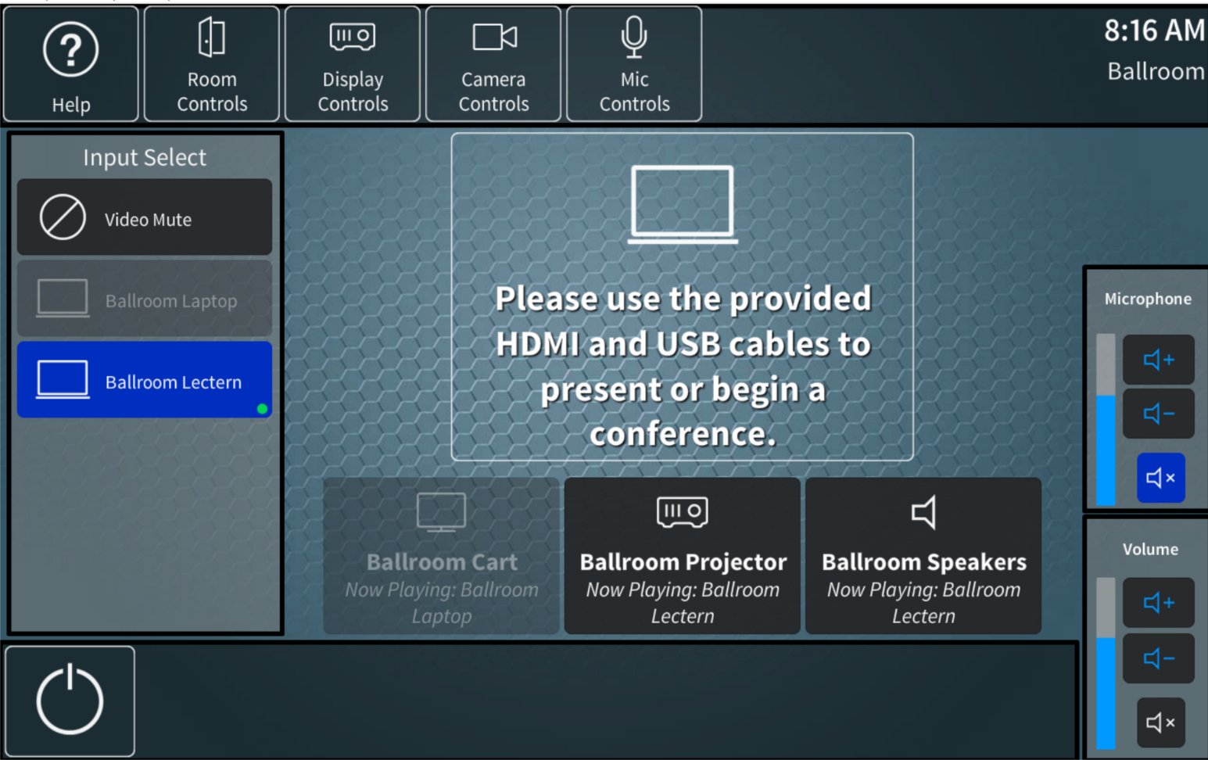
Status Indicators
The source list and destination list in each room change depending on the status of the endpoint. If an NVX transmitter or receiver is damaged, unplugged, or otherwise unable to communicate with the control system it will be greyed out, and not selectable by an end user.
In this example, the Ballroom Laptop transmitter is offline, and the Ballroom Cart receiver is offline, indicated by the orange arrow

Slide 15
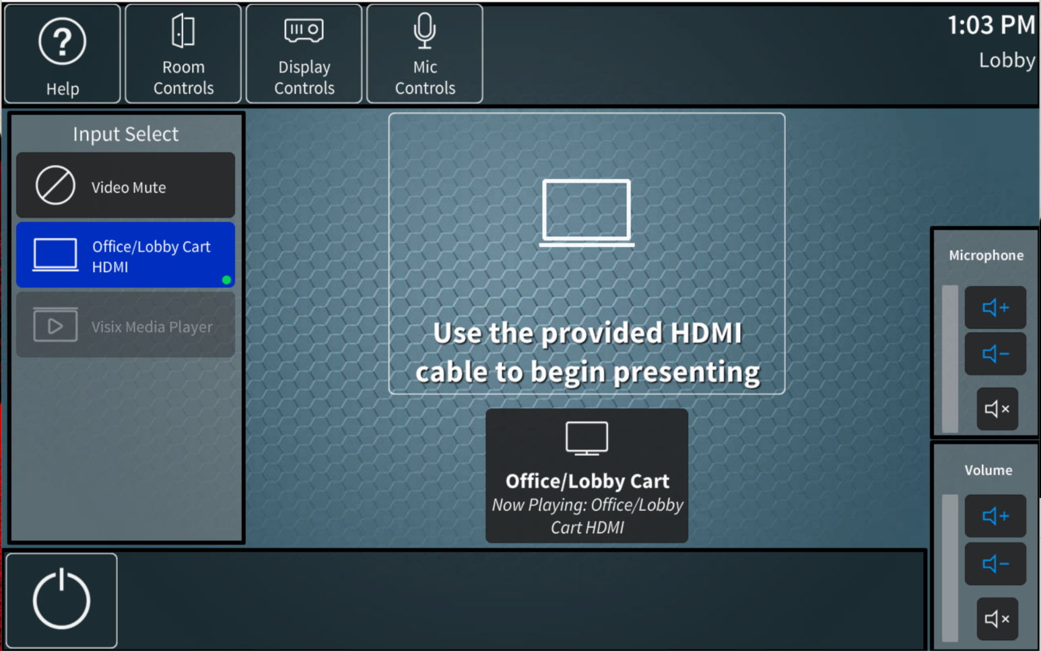
Status Indicators – Cont.
When a green dot appears, this indicates that a valid video signal has been detected by the transmitter. If a user connects their device (Laptop, Phone, Tablet, etc.) and this green dot does not appear, this indicates that the provided cable may be damaged, or their device is not configured or compatible with the provided cable or connection.
In this example, the Office/Lobby Cart HDMI has detected a valid video source, meaning that an end user has correctly connected the provided HDMI cable to their device, and their device is outputting a valid signal.

Slide 16
Status Indicators – Cont.
When a green dot appears, this indicates that a valid video signal has been detected by the transmitter. This indicator becomes especially helpful when rooms are linked together, allowing end users to instantly know if a source from another room has been correctly connected.
In this example, the Ballroom and Lobby are combined. The Ballroom Laptop has been connected correctly and is being detected by the system, but the Ballroom Lectern is completely offline, and the Office/Lobby Cart does not have a valid signal, meaning either nothing is connected, or the cable could have become damaged while being moved, or disconnected by mistake.

Slide 17
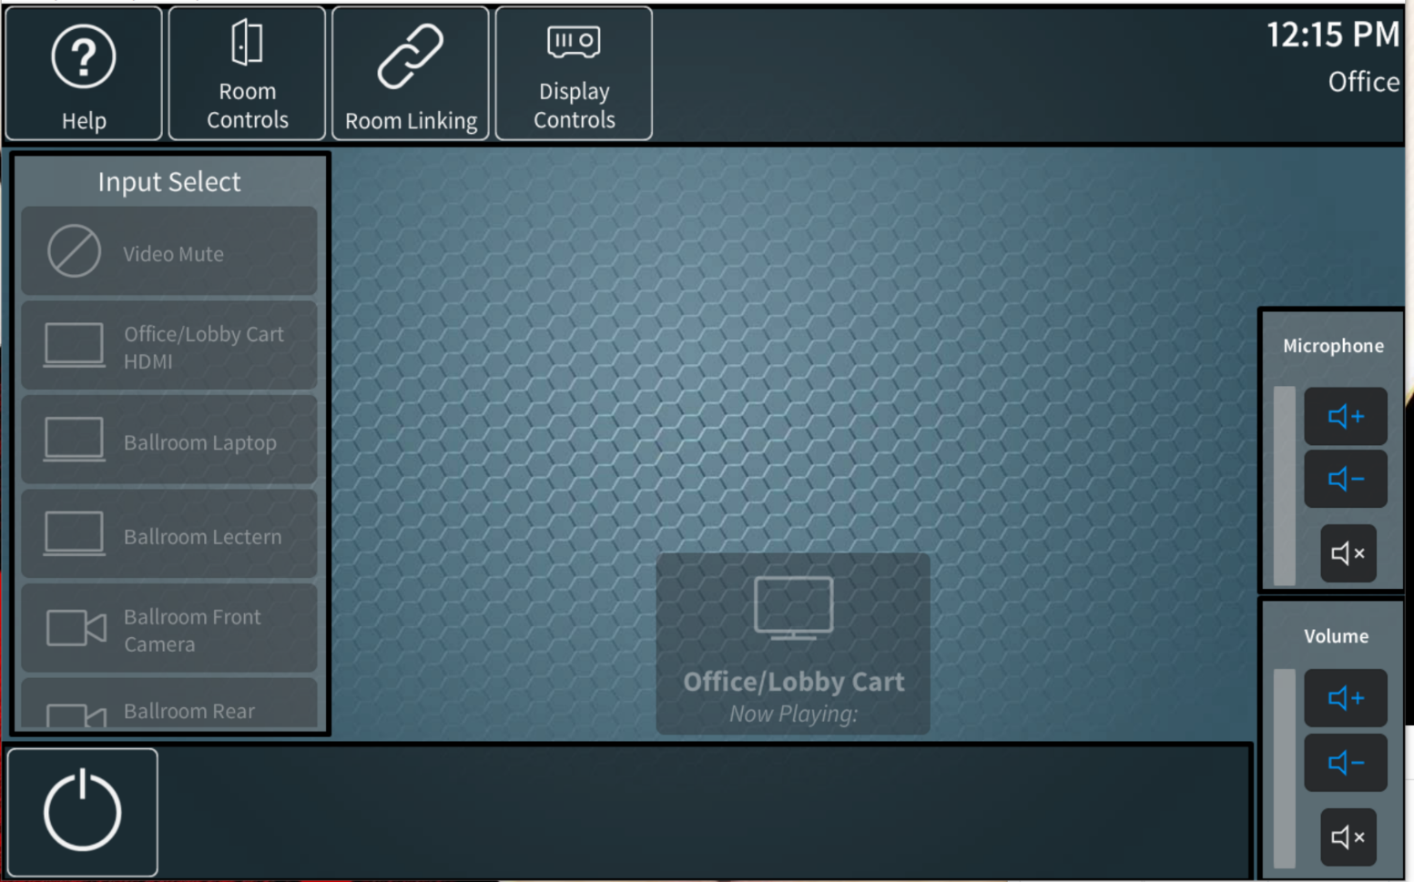
Additional Control Pages
The user interface will have several different pages depending on the equipment available to the room in which it resides. The iPad is the only interface with access to the room controls page. The possible pages are: Help Room Controls [iPad only]
Room Linking Display Controls Camera Controls Mic Controls These pages are accessed using the buttons on the header bar and are discussed in the following slides.

Slide 18
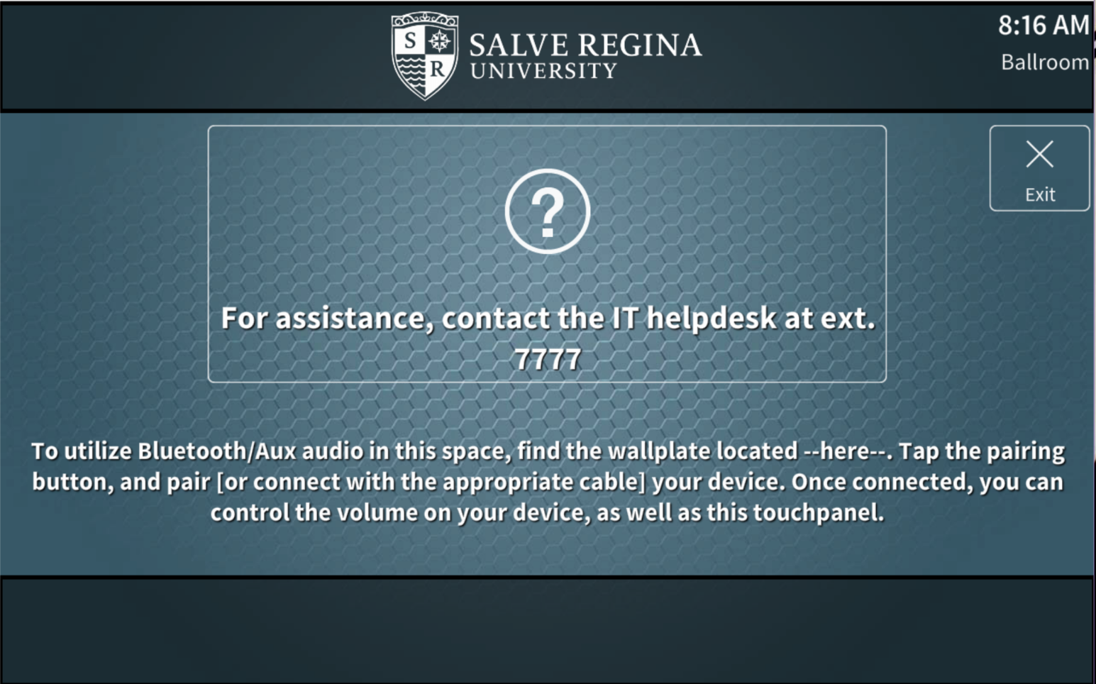
Help
The help page will have the standard help message. In addition, a small set of instructions indicating the location of the Bluetooth wall-plate will be shown to help users utilize this device. The Bluetooth wall-plate will be heard back in the room it is installed if a phone is correctly paired, and the source volume fader is un-muted.

Slide 19
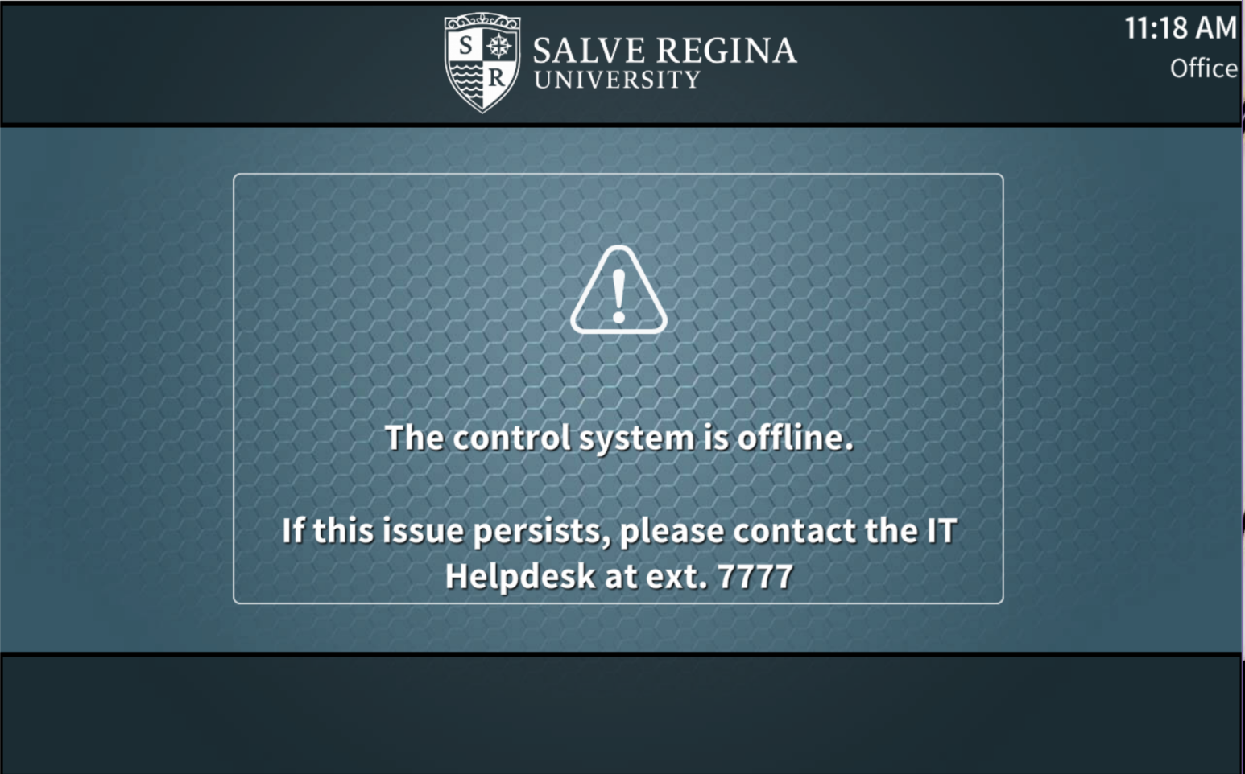
Offline
The offline page should only be visible to end users in the unlikely event that the touch-panel has been disconnected from the control system. This should only occur on touch-panels installed on mobile carts which may be moved from time to time. If this page is shown a network or connection error has occurred.

Slide 20
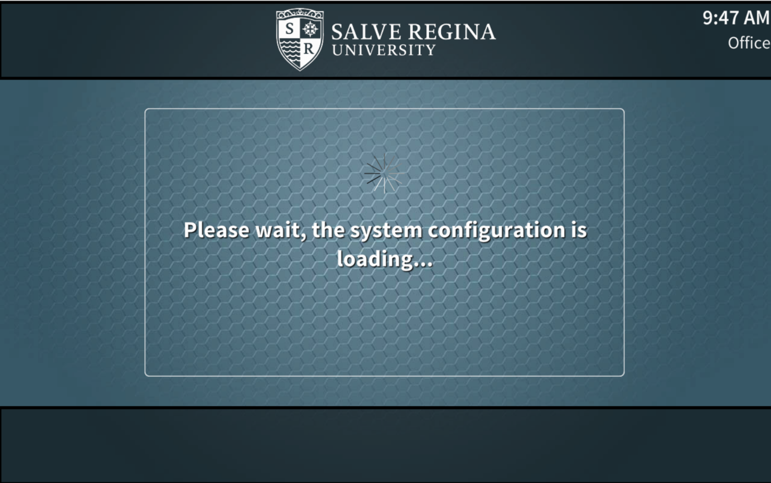
System Loading
The system loading page will be shown when the av system first boots, as it loads the necessary details and configurations. Once this occurs the page should be hidden, and normal operation should resume.
If this page is shown at any other time, an error has occurred.

Slide 21
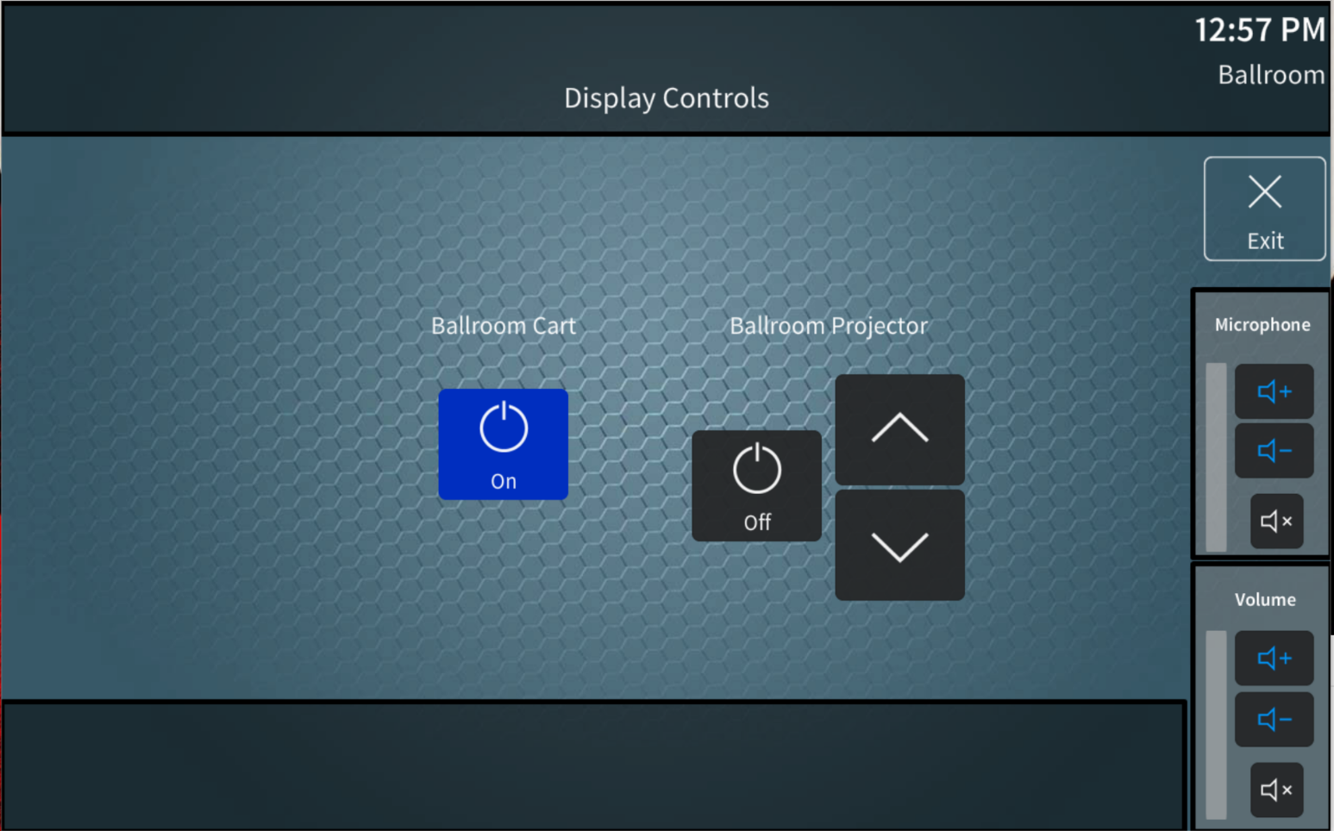
Display Controls
The display controls page will allow end users to manually turn displays on or off. They can also raise and lower projection screens [if applicable]. This should only be required if for some reason a display did not turn on automatically, or if an end user otherwise wants a display powered off without turning the entire system off. The power button will toggle the power, based on the state reflected on the button [if the button says “on” pressing it will turn off the display. If the button says “off” pressing it will turn on the display.] The text will change to reflect the current state of the display. The displays shown will change based on the linked status of the room.
In this example, the Ballroom Cart is powered on, and the Ballroom Projector is powered off.

Slide 22
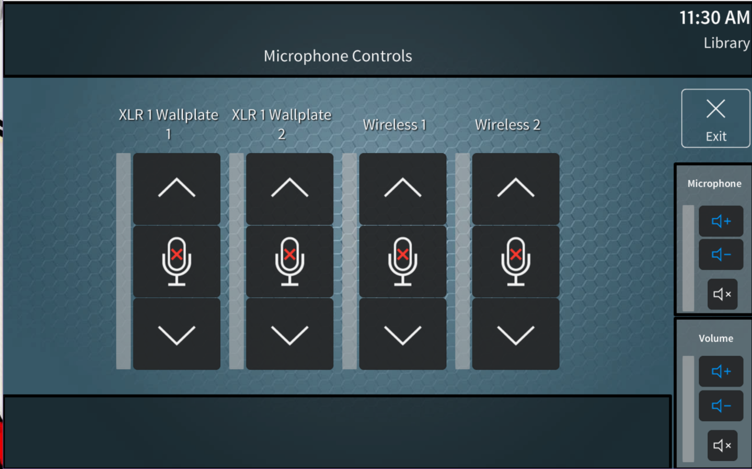
Microphone Controls
The microphone controls page allows for individual level control of the microphones available to a room. The microphones shown on the touch-panel will change based on the linked status of the room.

Slide 23
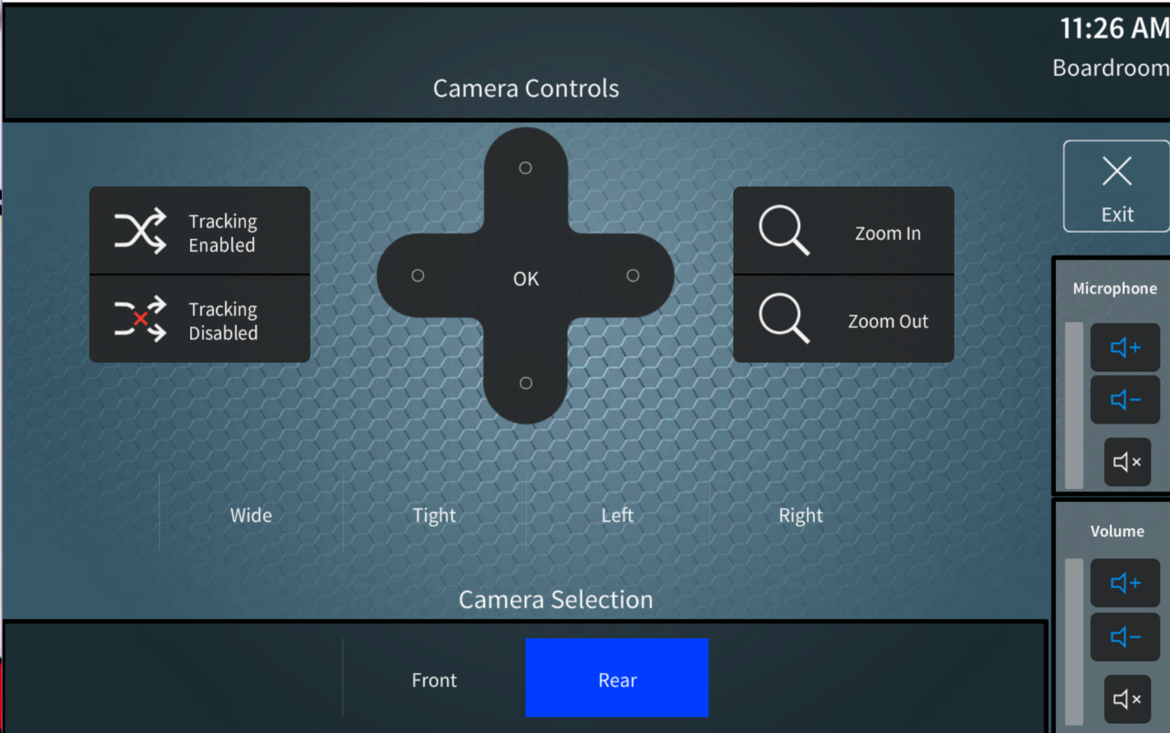
Camera Controls
The camera controls page will control the pan, tilt, zoom and preset saving/recall functions of cameras available to the room. Selection of a camera on this page will also determine the camera feed to be viewed by the video record plates, USB conferencing devices & video recorders. These are all synchronized for ease of use by end users. The cameras shown on the touch-panel will change based on the linked status of the room.
In this example, the Rear camera has been selected. This would result in the video record plate, the USB conferencing device & video recorder viewing the video feed for the Boardroom’s Rear camera.

Slide 24
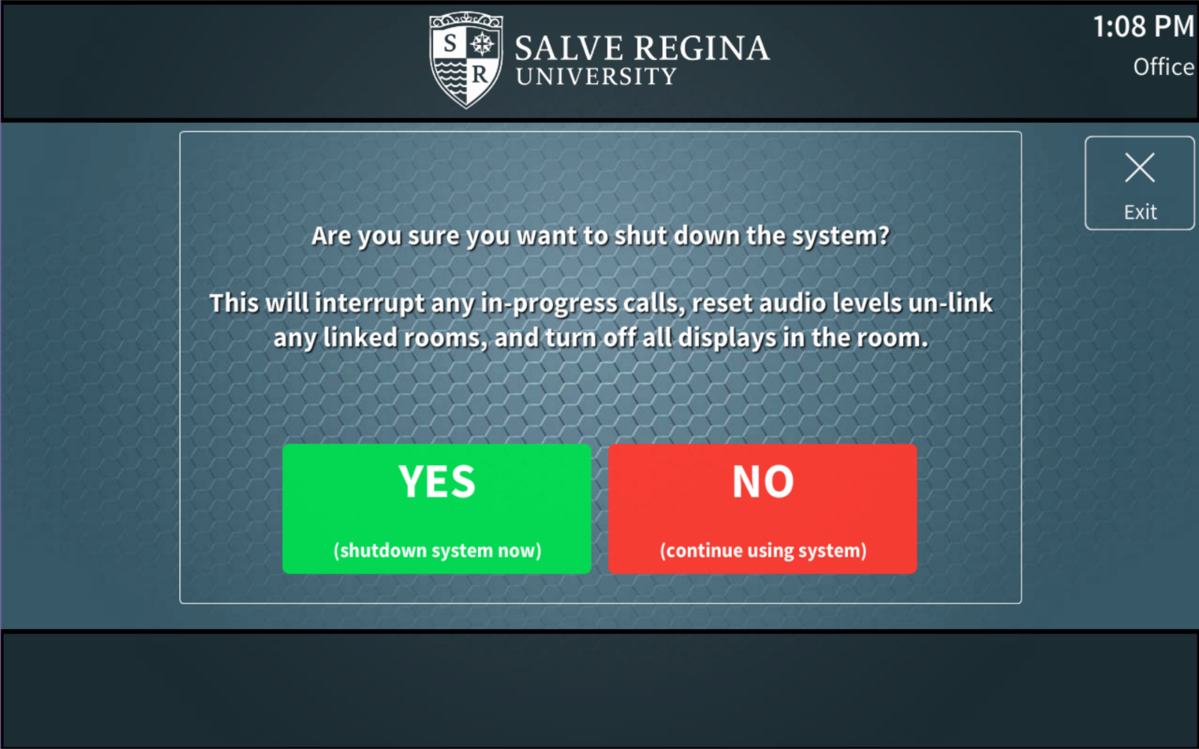
System Off
The system off page will ask the user to confirm if they truly wish to shutdown the system to prevent accidental shutdowns or interruptions of audio/video presentations. To shut the system down, the green button is pressed. To continue using the system, either the red no button or the exit button can be pressed. If a room is linked, shutting it down will also cause all other rooms to turn off. To prevent this, the room must first be un-linked and then shut down.
In this example, the Rear camera has been selected. This would result in the video record plate, the USB conferencing device & video recorder viewing the video feed for the Boardroom’s Rear camera.

